Slide 1
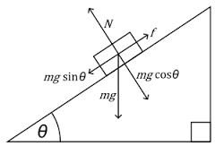

Voyage of Outlaws
Incline studios
Krazykatz.inc
By Jason Pearson & Khandker Faim Hussain

Slide 2
Overview: “Voyage of Outlaws”
The rules of the game:
Collect the fusion cores needed to advance through federacy space
Collect as many loose elements to score points
Importantly to survive waves of enemies by avoiding them as long as possible
This is an arcade style, 2D scrolling game
This game’s style and mechanics are derived from our 3rd assignment

Slide 3


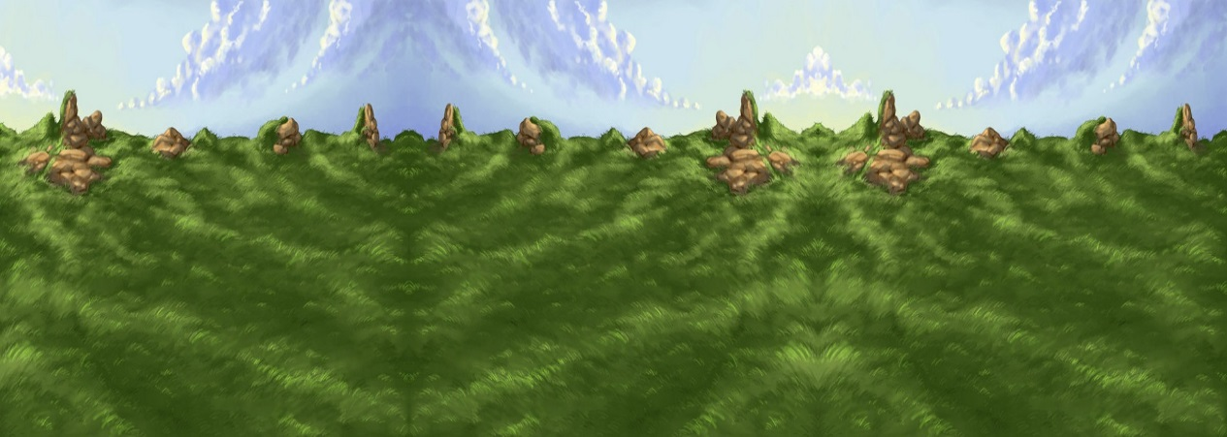

Overview: Game Structure
Game starts you off with 5 lives, then the next levels increment your remaining lives by 10
Your score also carries over each level in order to build up your final score

Slide 4


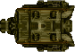

Objectives
Fusion Cores – Get the amount needed for each level in order to advance/win the game
Concentrated Uranium – 10+ points
Pure Lithodite – 30+ points, introduced in LvL 2
Solid Dark Matter – 50+ Points, introduced in LvL3
Patrol Ships – LvL1, takes 1 Life Upon impact
Bounty Hunters – LvL2, faster, takes 1 Life
Federacy Ships – LvL2, Slower, but takes 2 Lives
Galactic Fed. Military Warships – LvL3, larger on Screen, fast, takes 2 lives upon impact

Slide 5
Controls
Control the Ship with Moving the Mouse – Only Vertical Movement is affected
Having the ship making contact with Fusion cores and Loose elements allow you to pick them up

Slide 6
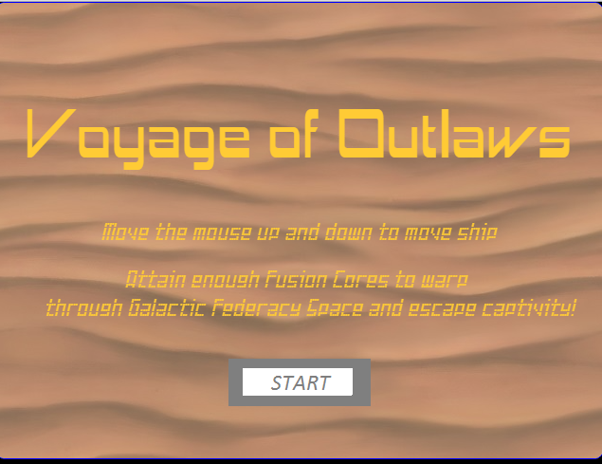
Instruction/Menu Screen

Slide 7
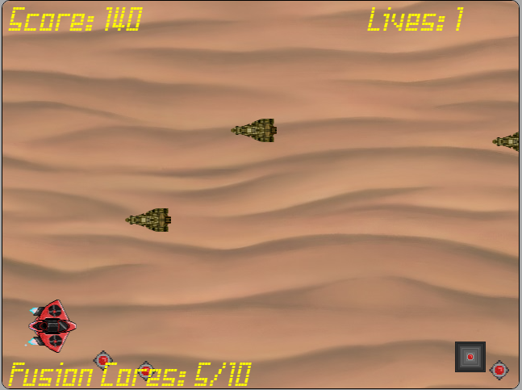
Level01 – Desert Planet of K’troth

Slide 8
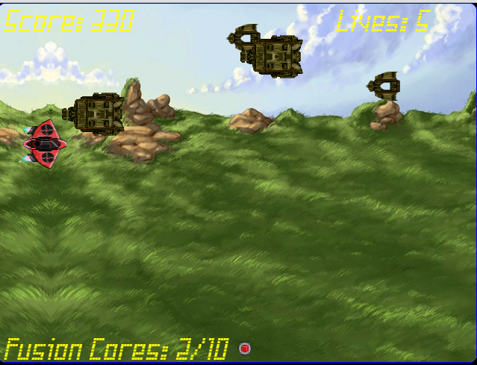
Level02 – Forest Eco-Sphere

Slide 9
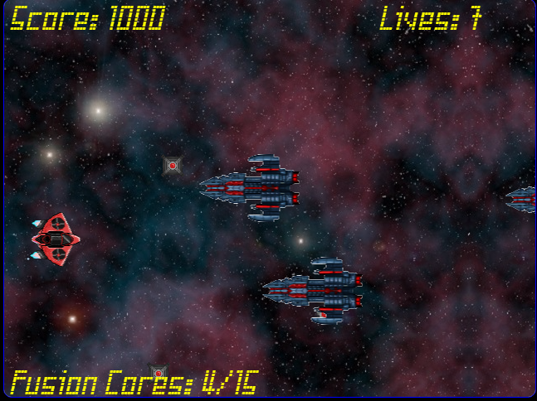
Level03 – Edge of Galactic federacy Space

Slide 10
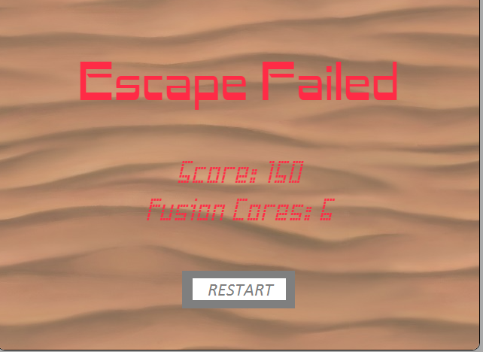
Game Over screen

Slide 11
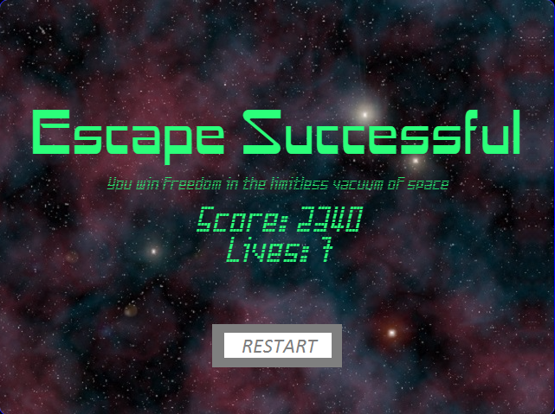
Win Screen

Slide 12
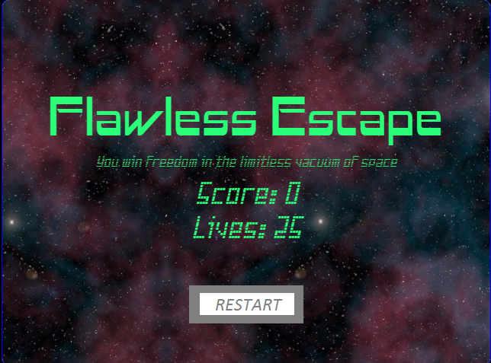
Win Screen – Flawless Escape
Never getting hit throughout the game (having 25 lives intact) gets you this win screen instead

Slide 13
Lessons learned
Better time management – A crucial understatement for us
No, really, everything else about this project was fine, but had we taken the time to learn CreateJS and other frameworks, we could have made this game even better.
Especially if we had time to learn the shooting mechanics, in the form of “Bullet Hell”, that we wanted to incorporate and have some sort of added complexity – you can see our intentions in our assets and external document (for first level).

Slide 14
Future possibilities
Create leaderboards
Scenes in-between finishing levels with story text and background (like a visual novel) – for story telling and giving context for level progression
Shooting mechanics
Weapon mods

